Slide 1
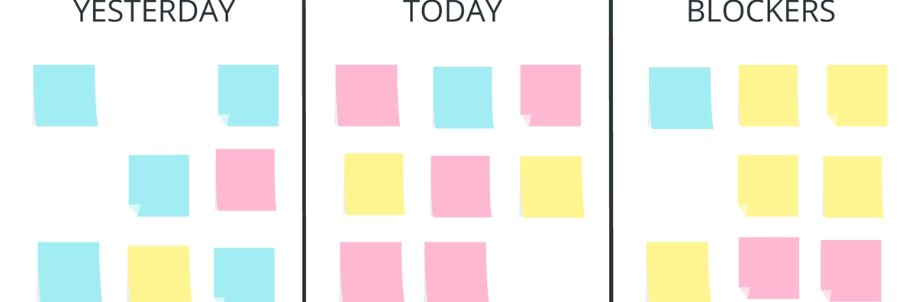
ABA 2022 – Team 02
Daily Stand-Up

Slide 2
House keeping rules
Turn on your camera, embrace the team spirit and show your commitment
Time-boxed: each member has max. 1:30 min
Do not interrupt
Who volunteers to take notes?

Slide 3
Daily Stand-Up
What have you worked on since our last meeting?
What will work on until our next meeting?
Which impediments, risks or issue do I have at the moment?
Do we need to take this up as a topic after the coaching?

